Slide 1
Invest and Reconstruct!
Cy Edmonds, Francis Kabongo, Huda Awad, and Lisa Godfrey

Slide 2

Motivation and Summary
As a construction company, we wanted to see where to focus our purchase of our next commercial site.
The questions asked were to eliminate the areas out of our criteria and find the best bang for our buck.
Commercial - Retail, sqft. = 50,000 - 150,000, Budget - $1337 per sqft. ($66,850,000 - $200,550,000)

Slide 3

Questions and Data
How many commercial sites match our criteria for area and cost?
Square foot matches per borough, cost matches per borough, and combined matches per borough.
What is the relationship for price and year built?
What are the trends we see with this historical data?
Comparing site matches to sales relationship, which borough(s) do we want to focus?

Slide 4

Dataset
To answer these questions, the data must have data for different boroughs in NYC and represents cost and square footage of each site.
Found in Kaggle.
https://www.kaggle.com/new-york-city/nyc-property-sales

Slide 5
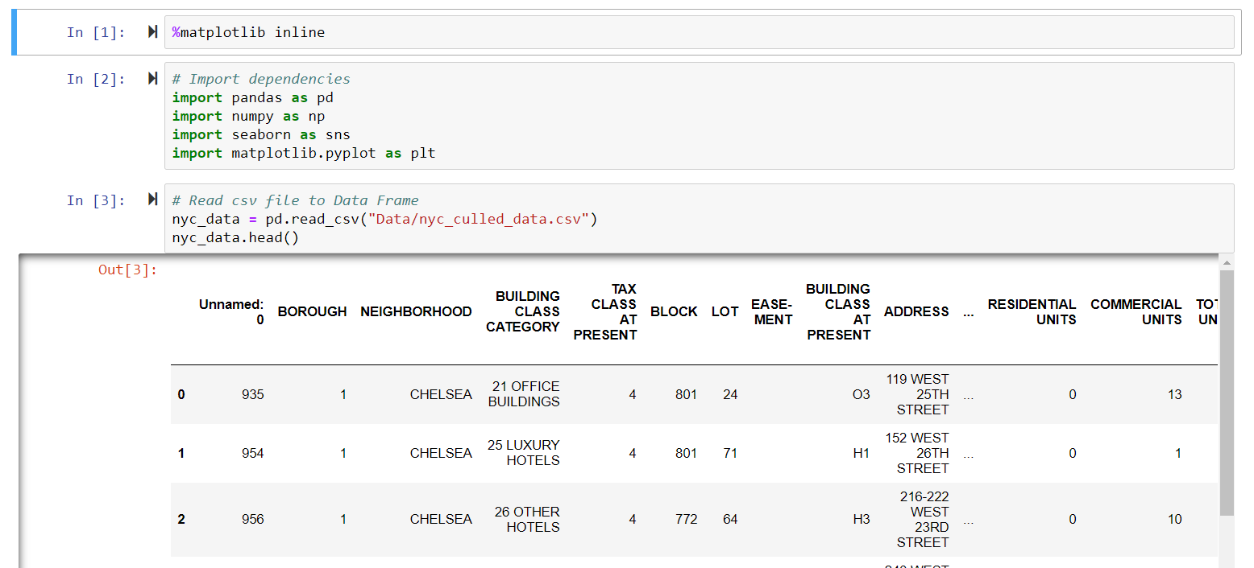
Here we go…

Slide 6

Data Cleanup and Exploration
Started with file nyc-rolling-sales.csv→
Created nyc_culled_data.csv
Excel:
Filtered to sorted by sales price to eliminate null values and zeros.
Filtered through residential and commercial units and kept only commercial data.
Python:
Assigned a string name for each borough, which were represented by a number. (ex: 1 represented “Manhattan”)
Filtered to keep borough Land Square Feet, Gross Square Feet, Sale Price, Year Built, and Tax Class at Time of Sale.
Made sure to set values as numeric to prevent string errors.
Created a new dataframe to pull additional column for Square Foot Value($).
Ran numeric conversion and filtered to remove values below 50,000 Gross Square Feet and remove values above 1337 Square Foot Value($) .
Group by on Borough and Square Foot Value to find matches for our criteria.

Slide 7
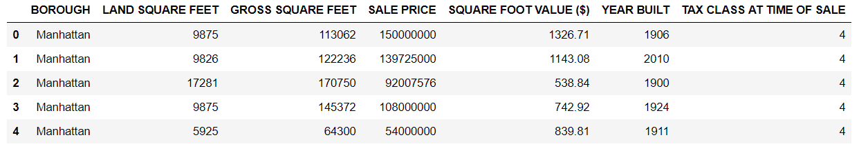
Data Cleaning
NYC Property Filtered

Slide 8
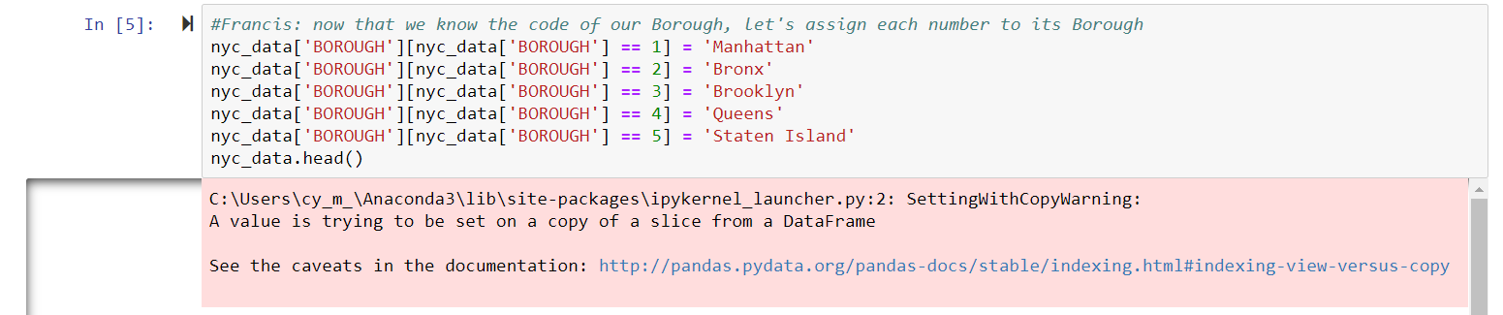
Data Cleanup and Exploration
Did not anticipate needing to convert column series to numeric.
Error:
Copy warning, stating that we are posting over original values.
In this case it suits our purposes, so we ignored the error message.
Notes:
copy warning, stating that we are posting over original values.
in this case it suits our purposes so we ignored the error message.

Slide 9
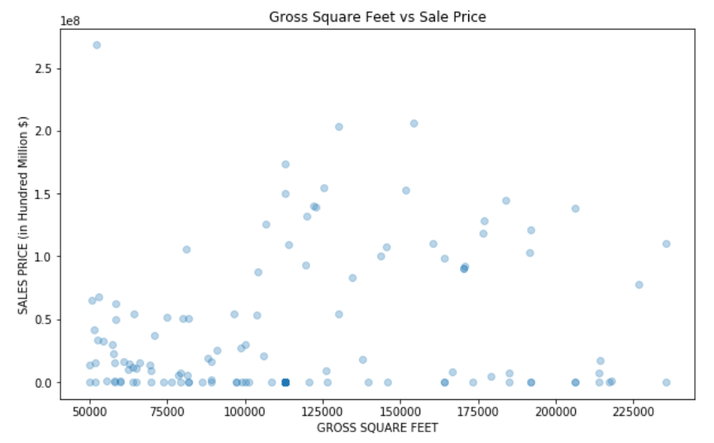
Data Analysis
No clear trend between Gross Square Feet and Sales Price.
The prices of the data skewed in the fact that many prices were lower than $1,000.

Slide 10
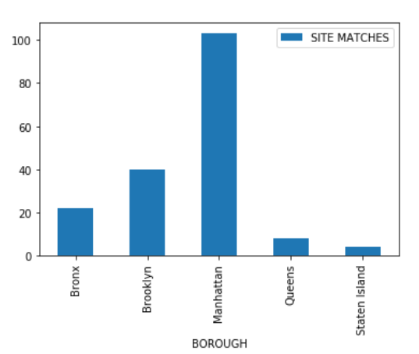
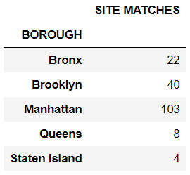
Data Analysis
Site Match Bar Graph to represent the number of sites that match our criteria by each borough.

Slide 11
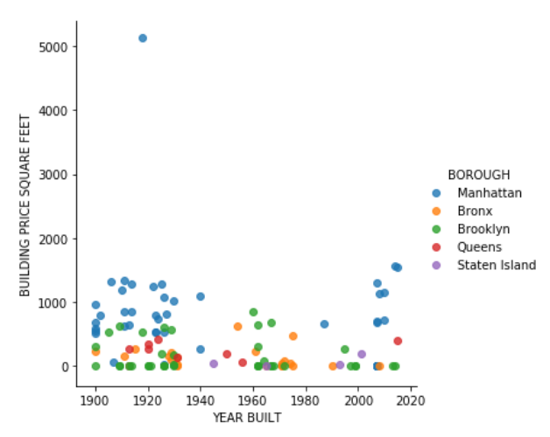

Data Analysis
Comparing Price per Square Feet and Year Built
Manhattan vs. Brooklyn

Slide 12
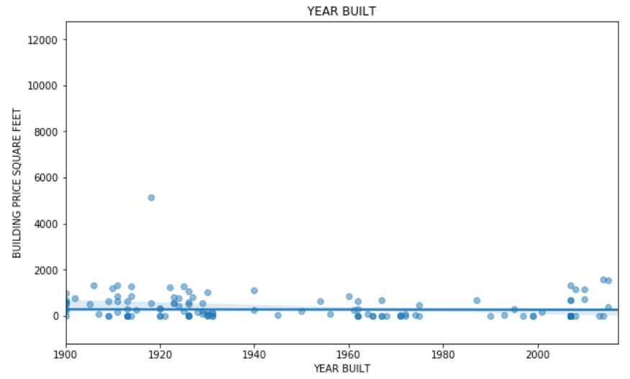
Post Mortem
1. Commercial vs Residential. Cost mixed for both.
2. Does not reveal trends over time. Making it difficult to work with the data.

Slide 13

Additional Research
Using updated Rolling Sales Data 2018-2019 and comparing it with the previous data.
Explore commercial rent rates.
Flip or rent out.

Slide 14


Questions
Comments

